Slide 1

sta k: Quick Start
Acri-20191105
Learning Goals
Describe data shapes and manipulations
Understanding how to work with a script in Rstudio
Basic working w/ tidyverse
Use an example vignette to investigate new pipelines
(BONUS) Download R, RStudio, create a GitHub

Slide 2
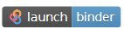
Logistics
Introduction
On your own laptop/tablet:
Go to: github.com/domjacri/git_stark
Scroll down and click . This may take a minute or two.
In the meantime:
Please fill out the pre-assessment
The 5 minute quick quick start

Slide 3
The 5 minute quick quick start
Learning Goal 1
Basic tools:
x = 1 or x <- 1
y = c(1,2,3,4)
plot(x, y)
library(“ggplot2”)
?ggplot2
??ggplot2
function(arg1 = , arg2= )
t.test()
aov(y~x)
Description:
“naming a variable”
“naming a vector”
“plot a scatter plot x versus y”
“load in the function ‘ggplot2’”
“open help/manual in RStudio"
“open information in Web Browser”
“run function with 2 arguments”
“basic t.test”
“basic one-way anova output measurement y, factor x

Slide 4
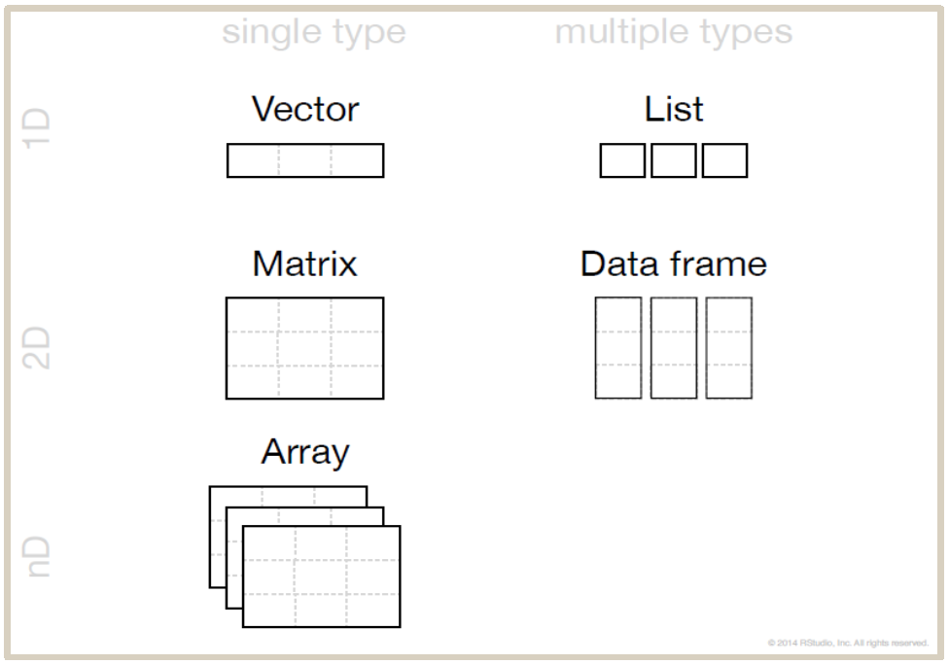
The 5 minute quick quick start
Learning Goal 1
What does data look like?
Types:
Logical (T/F)
Numeric (1.1)
Integer (1)
Double
Dimensions:
1D: i.e. (“a”, “b”, “c”, “d”, “e”, “f”)
2D: i.e. (5x2, scores of 5 students for 2 tests)
3D: i.e. (MUCH MORE COMPLEX)
1 type only
Multiple types
Complex
Character (“a”)
Raw
List
1D
2D
nD

Slide 5
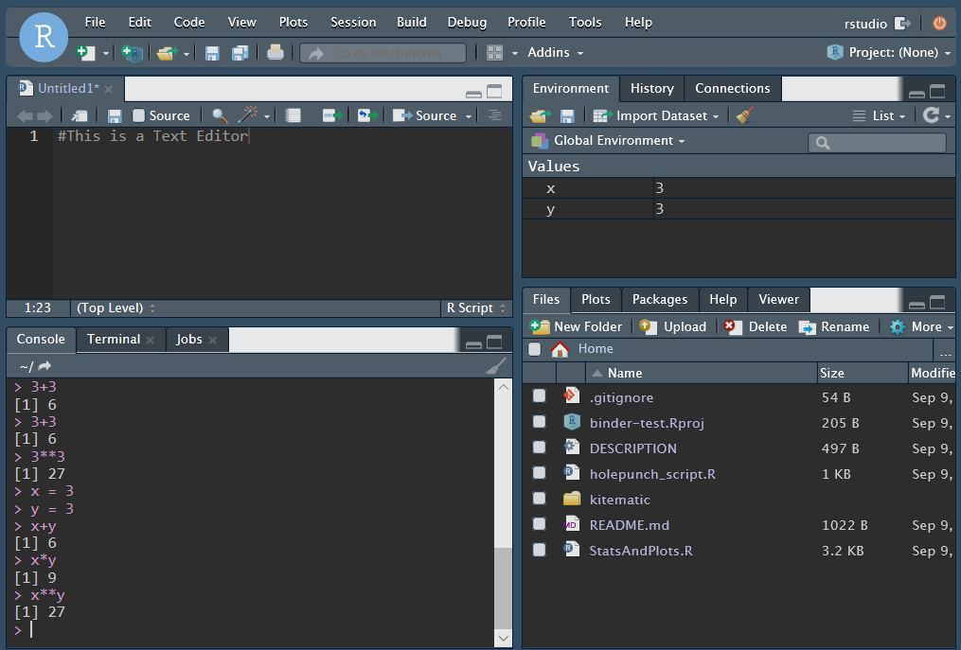
The 5 minute quick quick start
Learning Goal 2
R: A coding language (the internet)
RStudio: An IDE (google chrome)
Editor
Environment (+ et al.)
Console
Working Dir See plots, etc.
Package + Help

Slide 6
The 5 minute quick quick start
Learning Goal 2
R: A coding language (the internet)
RStudio: An IDE (google chrome)
Editor
Environment (+ et al.)
Console
Working Dir See plots, etc.
Package + Help

Slide 7
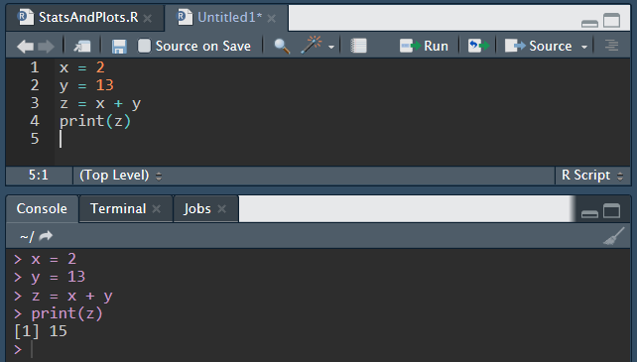
The 5 minute quick quick start
Learning Goal 2
Scripting:
You don’t have to do everything “in pen” (console)
Using the text editor you can “draft” (called scripting) and run line by line or all at once!
Use the “Run” button or Ctrl+Enter to run one line or highlighted lines

Slide 8
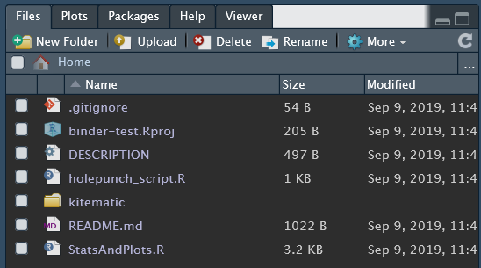
The Quick Start “Lab”
Learning Goal 2
Is everyone’s browser RStudio loaded?
Caveats:
This is an “image” of an RStudio session
You are all sharing the same image like everyone sharing the same USB stick
This is the first time I am trying this, if it is slow I’m sorry you are my Guinea pigs ☹
At the end of this session, I’ll show you how to download it on your own computer. This takes some time.
Click to open our demo!
Please ignore for now.

Slide 9
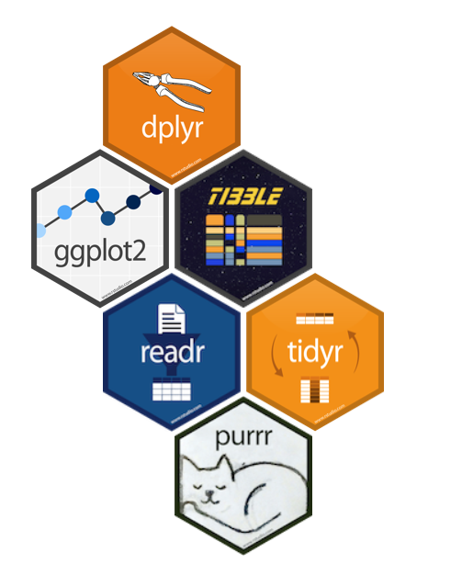
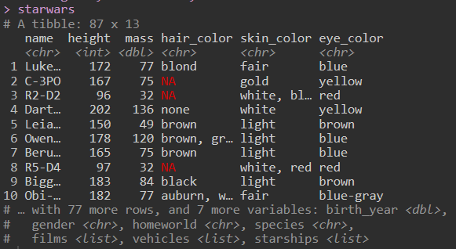

Exploring Data Science
Learning Goal 3
Tidyverse
Tidyverse: a package of packages for Data Science
Shared philosophy, grammar, and data structures
Dataset
https://www.tidyverse.org/

Slide 10
Moving To RStudio
Learning Goal 3
Here we will run through the StatsAndPlots.R script.
If you are following online and need assistance please feel free to email me dacri@iu.edu with the subject line [question about git_staRk] I will do my best to answer.
Please note that comments (# this is a comment) should help you get through.

Slide 11
YOUR RESEARCH: Working w/ Vignettes
Learning Goal 4
Pros
Some vignettes are well annotated & helpful
You can access cutting edge analyses for your research
Novelty, increase impact, free to do ANY analysis you’d like
Differential Expression of RNA data
DEseq edgeR
Single cell RNA seq analysis
Seurat
Image Analysis
magick
Network Analyses
visNetwork
Learn Statistics in R
swirl Learn R in R with Stats
Cons
Some assume advance coding knowledge
Installing custom packages takes time

Slide 12
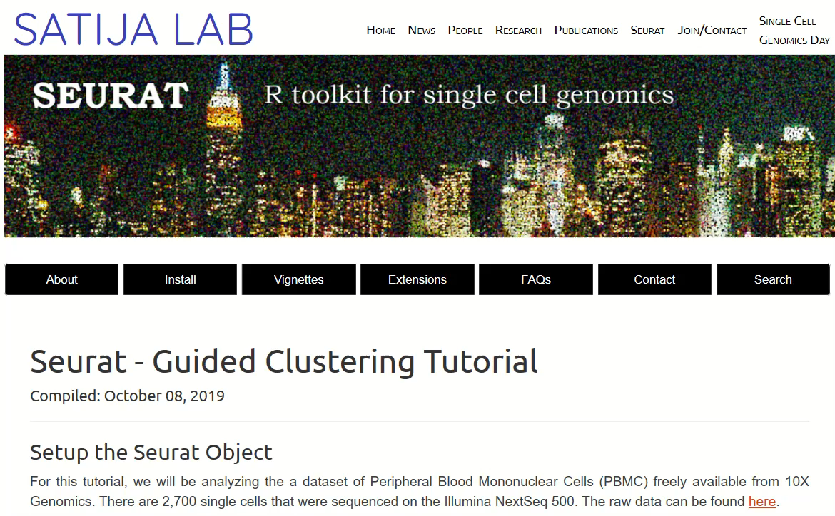
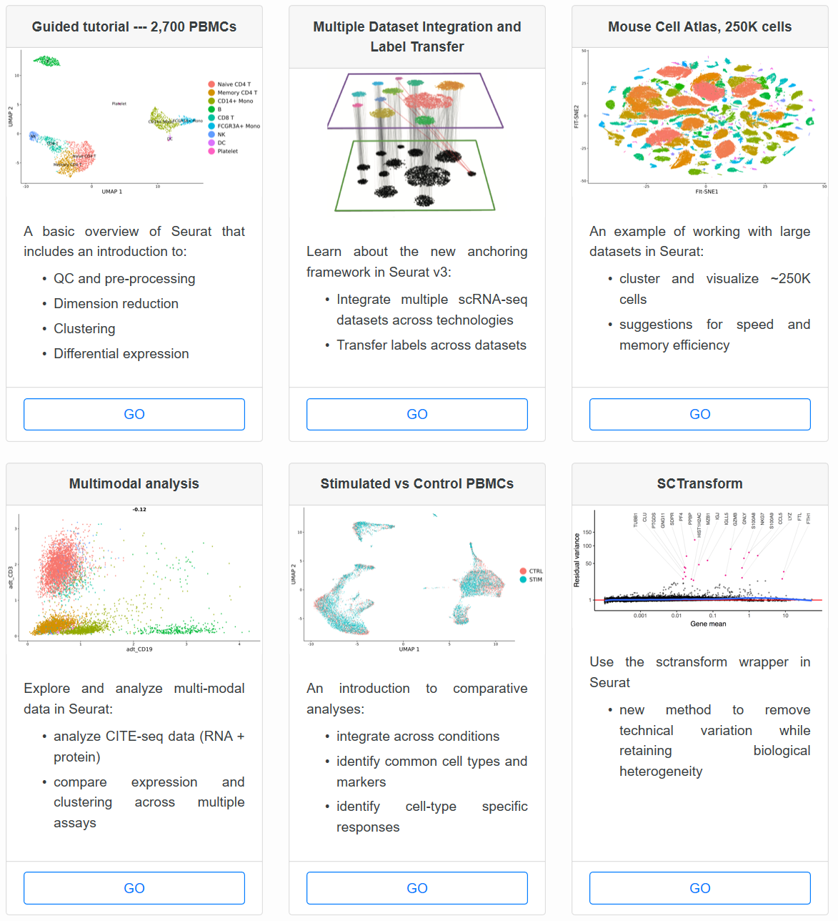
Seurat: an example
Learning Goal 4
Select Vignette for your Study:
https://satijalab.org/seurat/v3.1/pbmc3k_tutorial.html

Slide 13
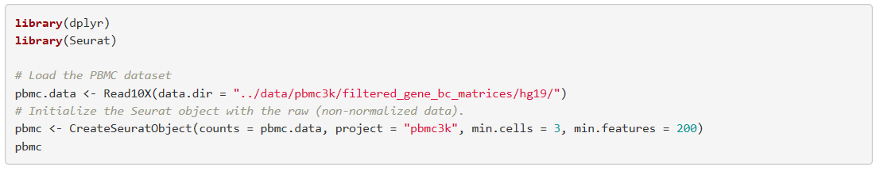
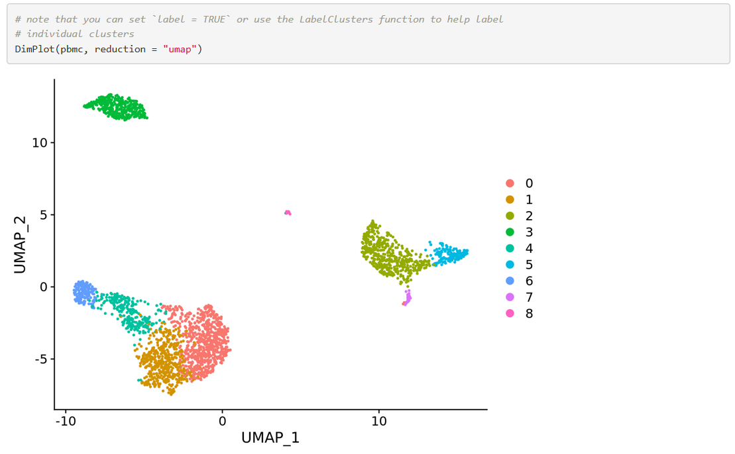
Seurat: an example
Learning Goal 4
…
Tips:
Don’t let a busy vignette scare you
It’s just a more complicated version of what we did today
Practice, practice, practice
notes
function
example output

Slide 14
What to do when you find a new package
Learning Goal 4
Look for a github page or website
Find “Install” tab
Look for a vignette that is closest to your intended use
Follow the demo with their dataset
Try again with your dataset
ASK Q’s: people make these packages so you will use them, it’s in their interest to answer your questions!

Slide 15
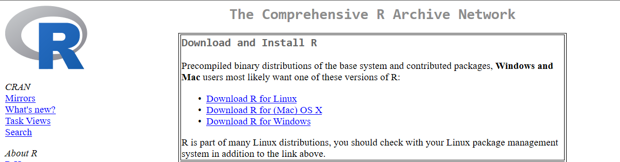
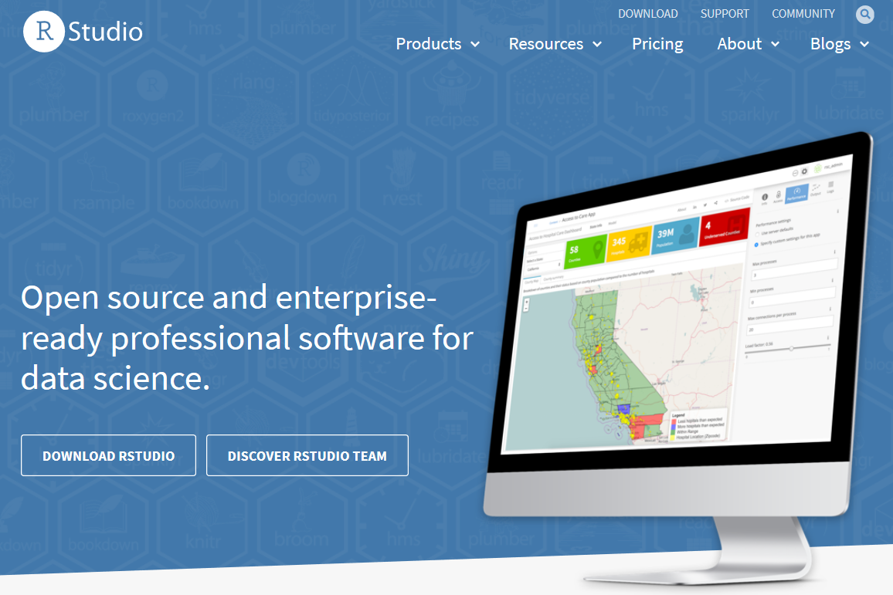
Downloading R & RStudio
Learning Goal 5
https://rstudio.com/
https://cran.r-project.org/
CRAN is a “store” where you need to download R
CRAN is also where you “buy” packages from using install.packages(“”)
alternatives: bioconductor, github
Download RStudio
Resource tab: Webinars, Cheat Sheets

